Slide 1
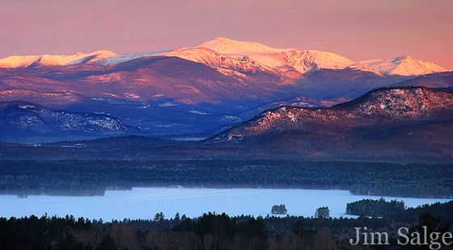
SAU9 State of the Schools
On the Road to Competency-based Education
January 18, 2018
Photo: Jim Salge

Slide 2
Goals for the Evening
Celebrate the progress towards our established goals
Develop understanding where we are heading and how competency-based education will help us achieve our goals
Gather data as to how community members define student achievement and growth

Slide 3
Developing the Plan
June 2015
Presentation and adoption of focus area 3
October 2015 CSB Adoption of Strategic Plan
The planning process—Development timeline
February 2015
Public forum to review survey results; Establishment of six focus areas with goals for each
Summer 2014
Desired outcomes identified
August Annual monitoring & evaluation report
December 2014
“We believe…” statements developed
August 2015 Presentation and adoption of focus area 4
May 2014
Vote to begin the development
October 2014
Public forum with work session on vision statement with Educational Consultant Elaine Millen as speaker
April 2015
Refinement of focus areas, goals and action plans with evidence
September 2014 Strategic plan “kick-off” meeting with retired Principal, Tony Simone as keynote speaker
July 2014
CSB selects steering committee members
January 2015
Surveys and analysis of strengths, weaknesses, opportunities and threats
September 2015
Edits and refinements to focus areas, goals and action steps
January 2016 Public rollout and implementation
May 2015 Presentation and adoption of focus areas 1& 2
November 2014
Mission, Vision and Belief presentation with Greg Frizzell from local radio, 93.5 WMWV as the guest speaker; Subcommittee selected to work on mission, vision and belief statements to guide strategic planning process
March 2015
Public forum and work session with the CSB to prioritize focus and goal areas
February Annual monitoring & evaluation report
July 2015 Presentation and adoption of focus area 5
Evaluation & Monitoring
STAGES:
Preliminary Work
Data Gathering
Mission, Vision & Values
Developing the Plan
Approval & Implementation

Slide 4
Core Values
“We believe…” statements
Mission: To cultivate the natural inclination to learn by providing an exceptional environment in which students embrace excellence in learning for a lifetime of success
Vision: Realizing the full potential of each and every student

Slide 5
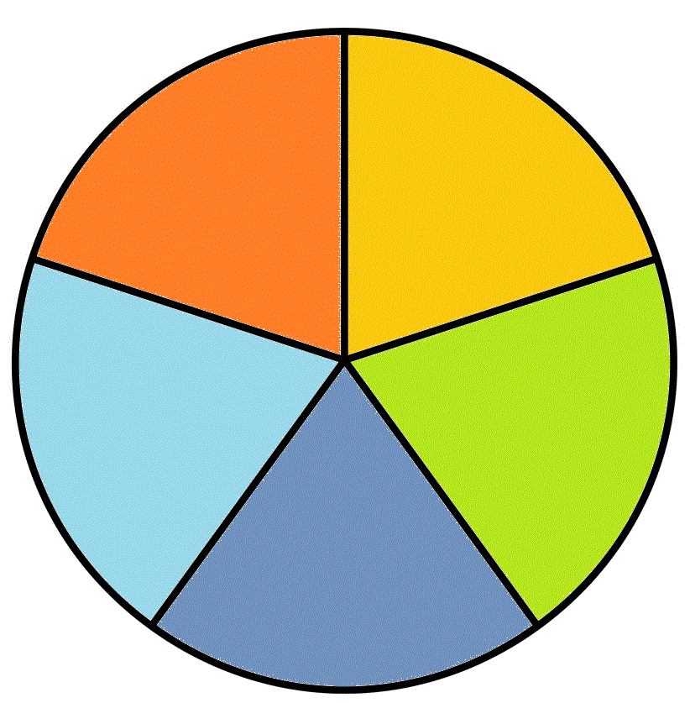
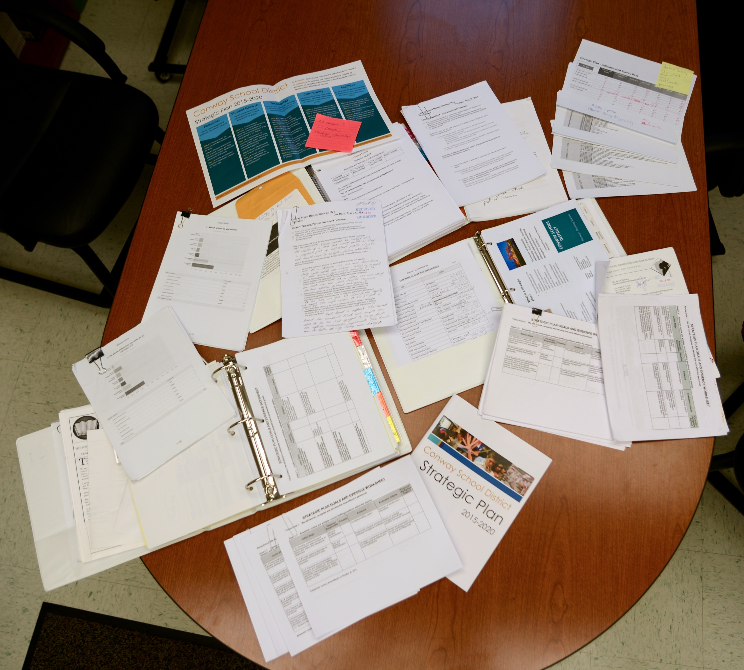
Summary
of
Focus Areas
Personnel
Community
Vision: Realizing the full potential of each
and every student
Facilities
Student Growth
Technology

Slide 6
The Strategic Plan
Focus Area 1:
Personnel
We will recruit, recognize and develop the most effective personnel
Indicators of success…
Increased retention rate from about 50% to over 80%
Increased ratio of applications to open positions by 66% since 2013 school year, while reducing costs over 40%
Of AP tests taken, 78.3% received scores of 3+, above national average of 71% and global average of 60%
SAT scores above state and national average the last two years, improving in 2017 over 2016
Regionally competitive salaries, i.e. Conway and Jackson starting salaries raised to median
Staff recognition of quality educators through administrative walkthroughs, feedback, opening classrooms for peer observation
“It is the supreme art of the teacher to awaken joy in creative expression and knowledge.”
~Albert Einstein

Slide 7
The Strategic Plan
Focus Area 3:
Technology
We will utilize appropriate technology to enhance student achievement and improve operational efficiency
Indicators of success…
Increased operational efficiency - New student information system, upgraded wireless connectivity and bandwidth
Technology plan developed and monitored
Reliable and current technology - 1:1 K-12, Clear obsolescence plan
Integration across curriculum - Flipgrid, SeeSaw, Google Classroom
Use for communication - Websites, School Messenger

Slide 8
The Strategic Plan
Focus Area 4:
Community
We will promote a school community that enhances educational opportunities and increases involvement in our schools by...
Indicators of success…
Improved communication to all stakeholders - Website
Increased volunteerism in schools - Strong K-Kids and nationally recognized Key Club, Parent and community volunteers working in schools (i.e. ESSC, SeaPerch, tiny house, PTAs)
Continued business support and collaboration - Work with Economic Council, ELOs and internship opportunities

Slide 9
The Strategic Plan
We will provide appropriate facilities and physical resources to support the current and future needs of the district
Focus Area 5:
Facilities
Indicators of success…
Monitored financial matrix tied to goals and objectives - Collective bargaining considerations
Maximized facility utilization - Studies of building capacities and use, pursuit of local collaboration
Safe and healthy facilities - Collaboration with Homeland Security, Capital Improvement projects

Slide 10
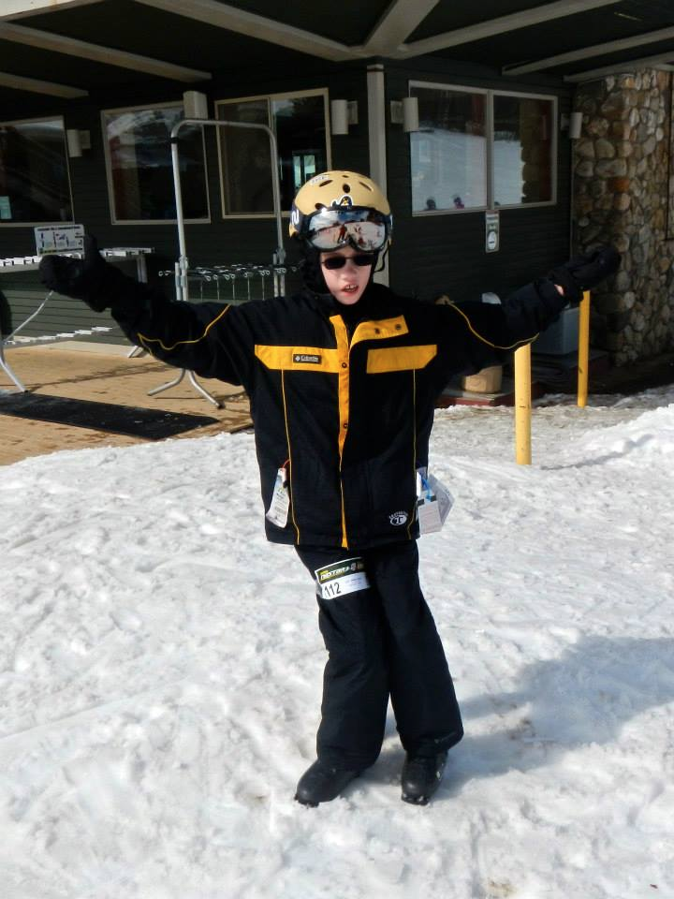
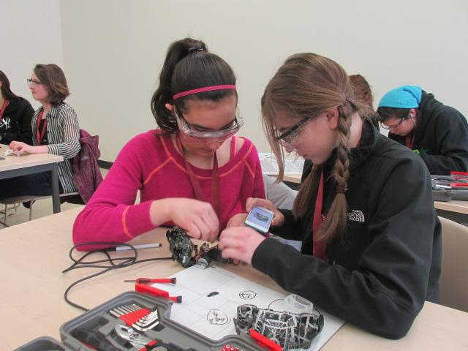
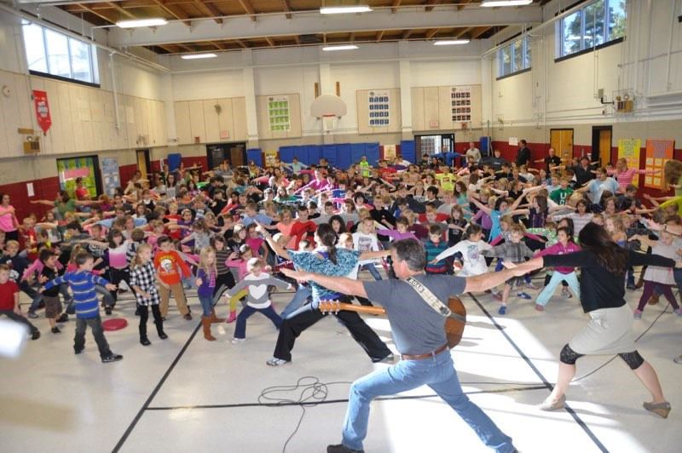
The Strategic Plan
Focus Area 2:
Student Growth
We will strive to continuously improve each student’s level of achievement and growth
Indicators of success…
Consistent curriculum, instruction and assessments practices
CBE Implementation Plan
Examples of student-centered learning - Workshop model, tiny house, TED talks
Collaboration among educators - Instructional seminars, Mentor programming, K-12 curriculum teams
Innovative programs - ELOs in development at KHS, Student-led conferences
Increased student achievement

Slide 11
Why are we moving towards a competency- based system of education in SAU9?
Link to video: https://www.youtube.com/watch?v=sucKTktHYA8&disable_polymer=true

Slide 12
We believe learning for everyone is a lifelong process that transcends the walls and hours of the school days.

Slide 13
We believe that students must learn to think critically, solve problems, and apply skills across content areas by engaging in hands-on experiences that are relevant to the real world.

Slide 14
We believe that learning must be differentiated in process, location, and pace; embracing arts, community, and diverse learning styles.

Slide 16
Link to video: https://www.youtube.com/watch?v=f_QJQz-8Y2Y

Slide 17
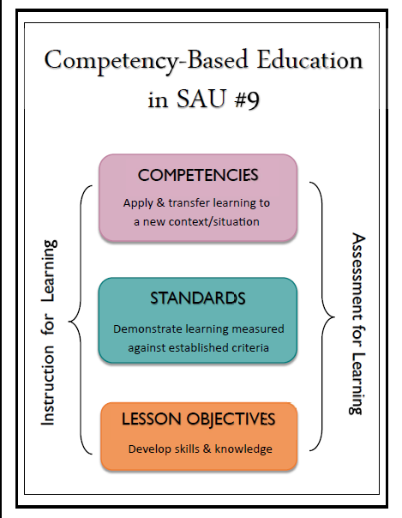

Slide 18
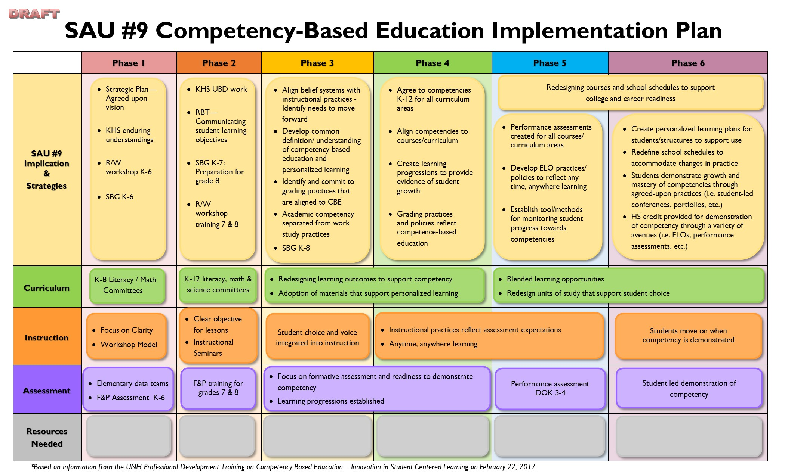

Slide 19
For our discussion this evening...
How will we, as a community, define student growth and achievement?
Realizing the full potential
of each and every student

